Slide 1
ENTERTAINMENT USING TECH FOR VISUALLY IMPAIRED CHILDREN
PROBLEM SPACE

Slide 2
HYPOTHESIS
Visually impaired people are not exposed to technology due to insufficient machines to cater or the blind

Slide 3
PROBLEM
Lack of sufficient entertainment material for visually impaired children.

Slide 4
Market(data)
Online method
Over 300,000 visually impaired persons in Kenya.

Slide 5
TARGET CUSTOMER
Visually impaired kids aged 5-12 years.

Slide 6
Competition
Zany Touch- LINK

Slide 7
Dot braille
Manufacturing company in south Korea in collaboration with safaricom.
Purposes for short mobile money transfer services

Slide 8
ATTRIBUTES
Full smart watch functionality
Super-light durable aluminum with battery that last 7 days
Bluetooth connection to phone

Slide 9
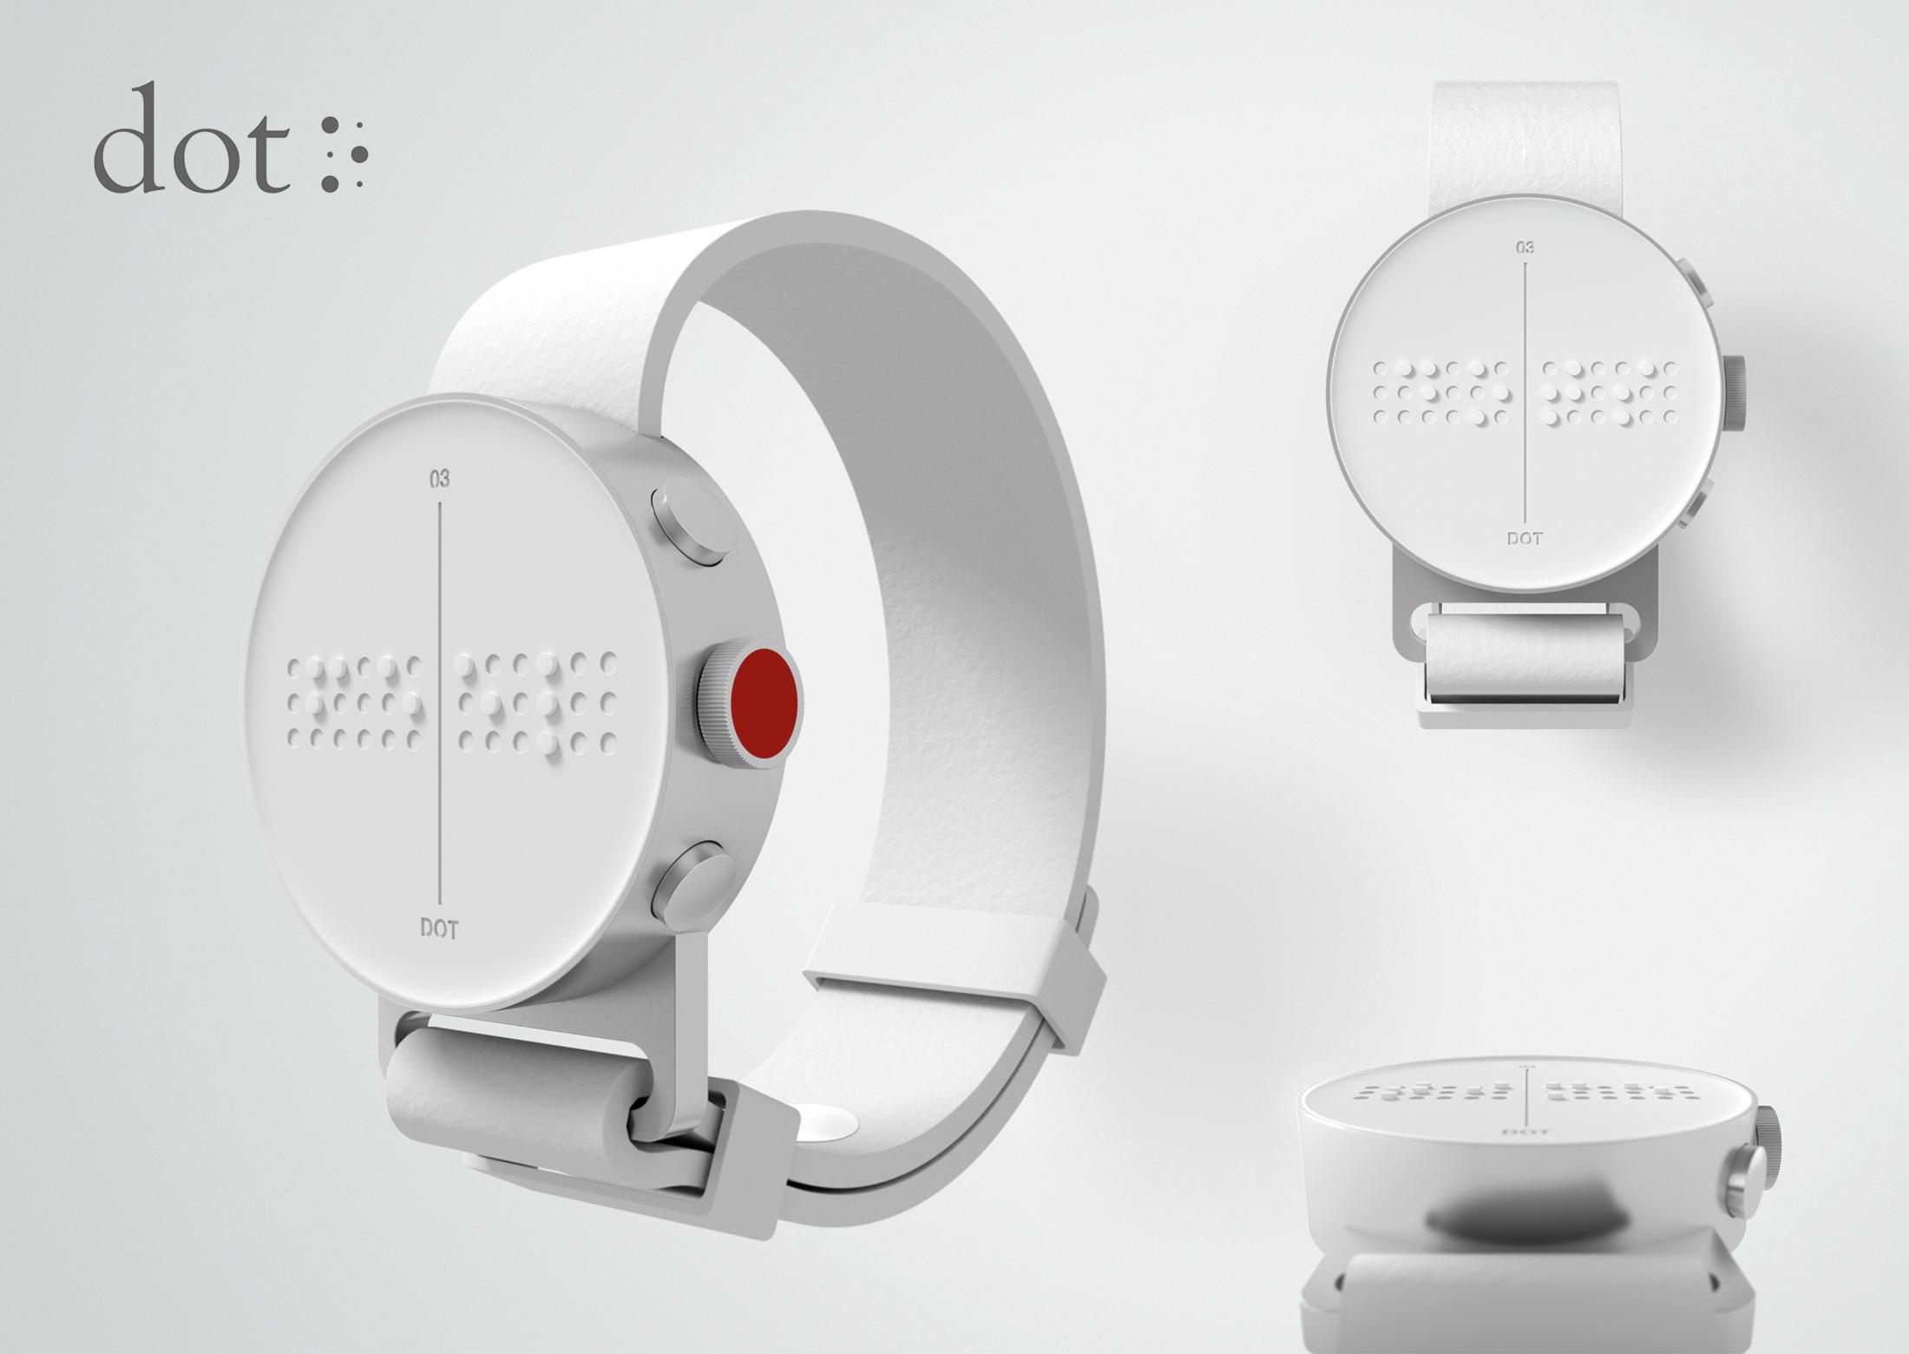
COST
Ksh25,350

Slide 10
Business Model
Product sales model

Slide 11
Tech Use
AI-Simulation of machine to “active braille technology”
Dot Matrix display

Slide 12
Strengths and Weakness
Strength
Weakness
Easy to read
Every message is translated into braille
Direct access to all features
super light durable aluminum
Batteries last for 7 days
Customers care are trained to assist them
Used in phone and can be translated
Expensive
Only Safaricom users can access

Slide 13
Value proposition
Portability of device
Diversity(catering for all mobile networks)
Automated customer care services

